Slide 1
Government arts college, coimbatore pg & research department of zoology
PARTICIPATION BY M. Sc. ZOOLOGY STUDENTS
IN THE INTERCOLLEGIATE COMPETITIONS
CONDUCTED AT
NIRMALA COLLEGE FOR WOMEN, COIMBATORE,
AS PART OF THE
WILDLIFE WEEK - 2018 CELEBRATIONS

Slide 2
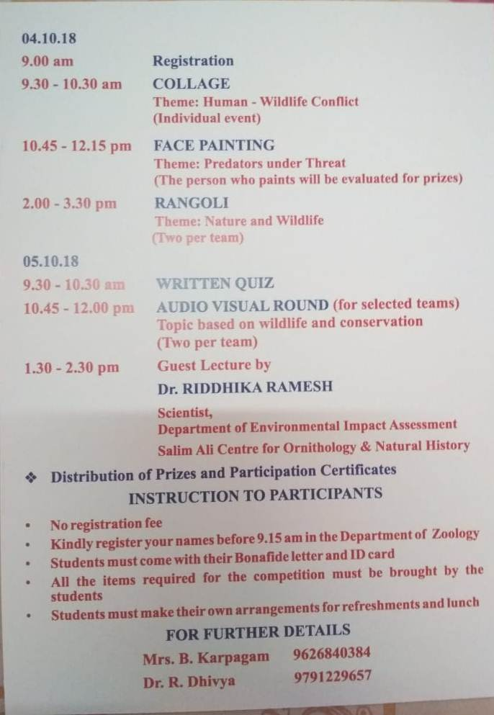

Slide 3
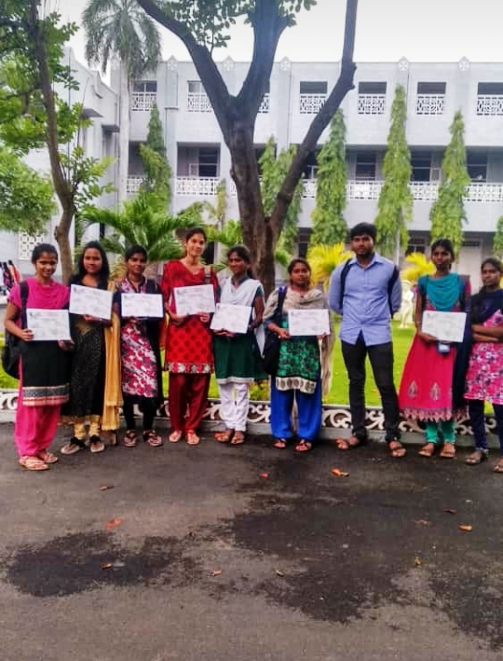

Slide 4
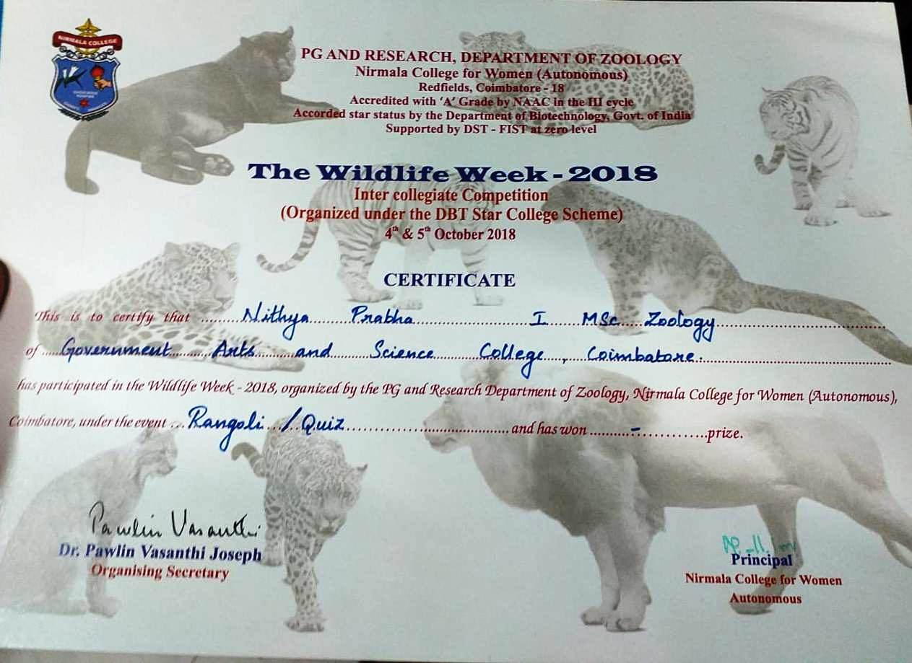
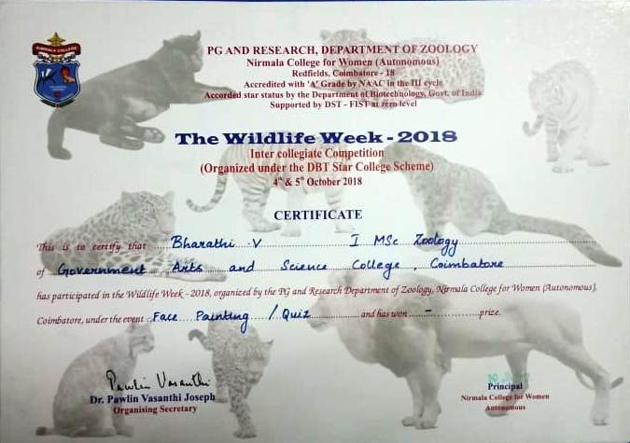
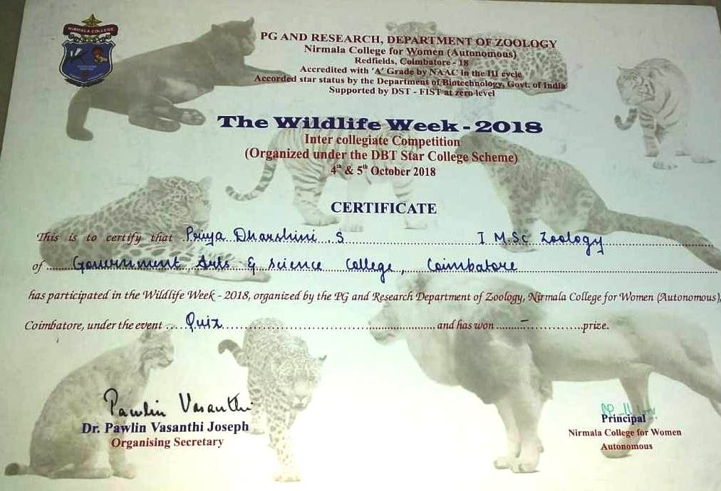
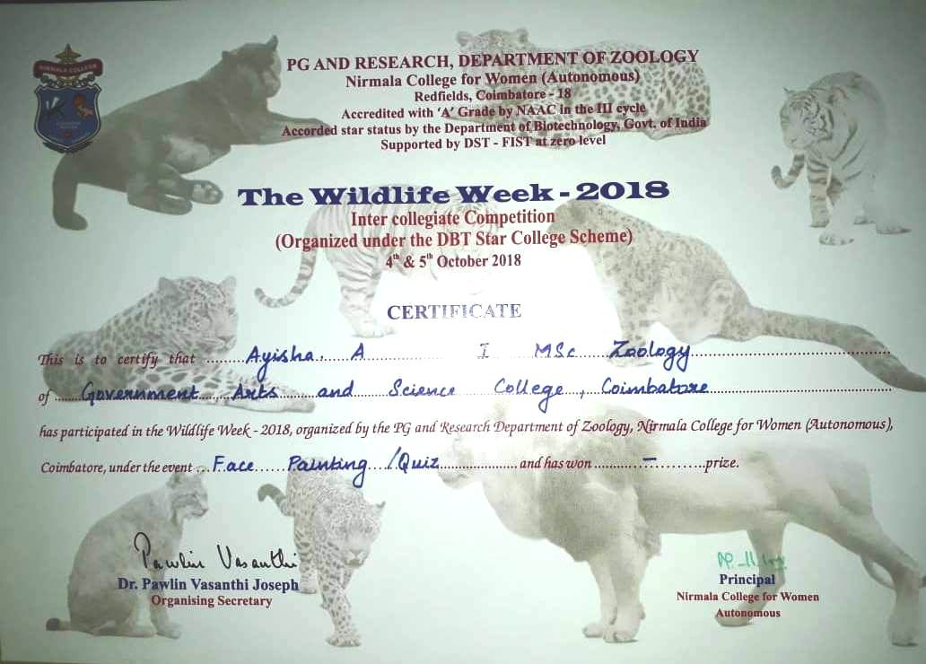
QUIZ COMPETITION

Slide 5
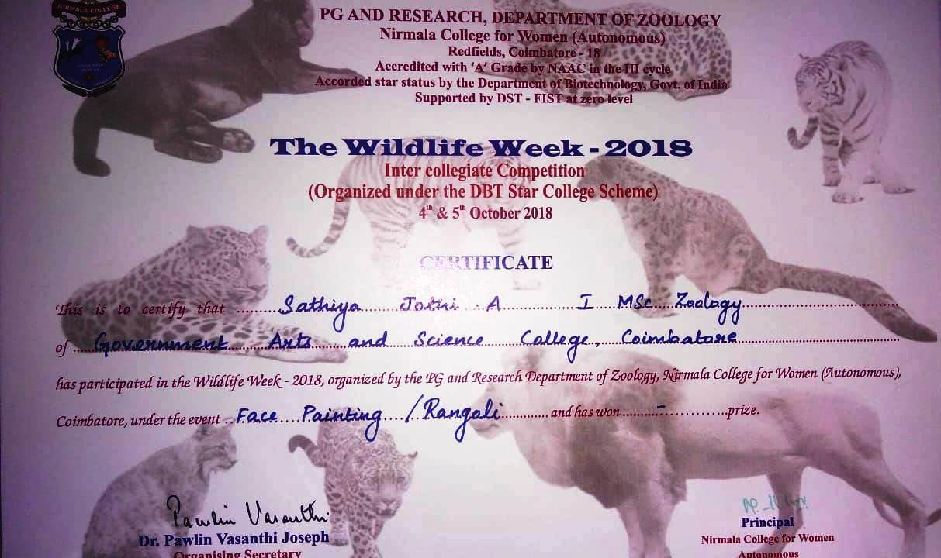
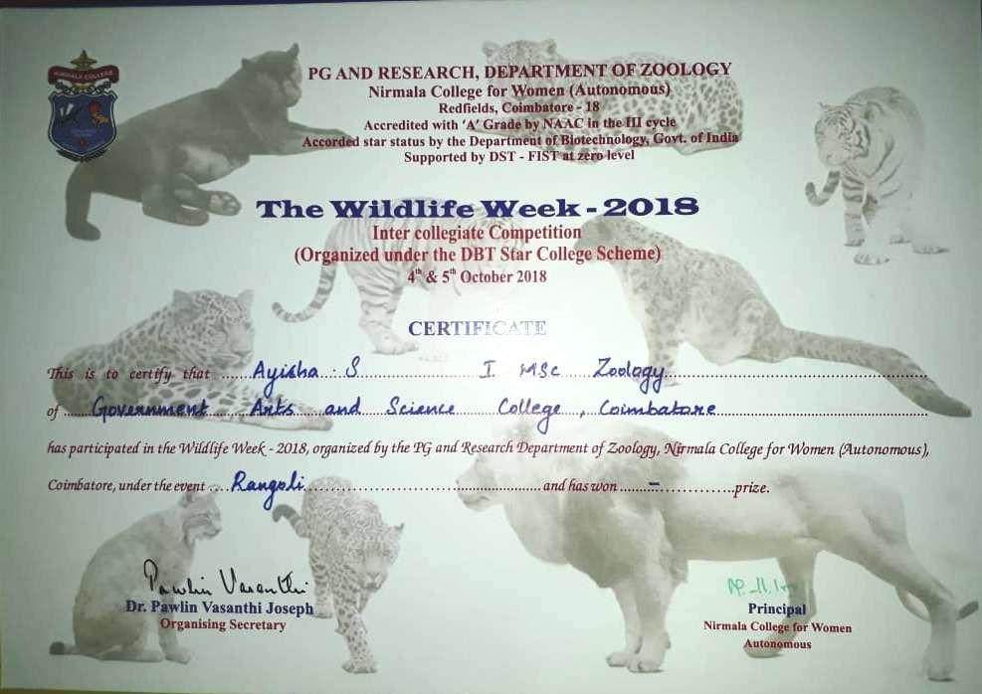
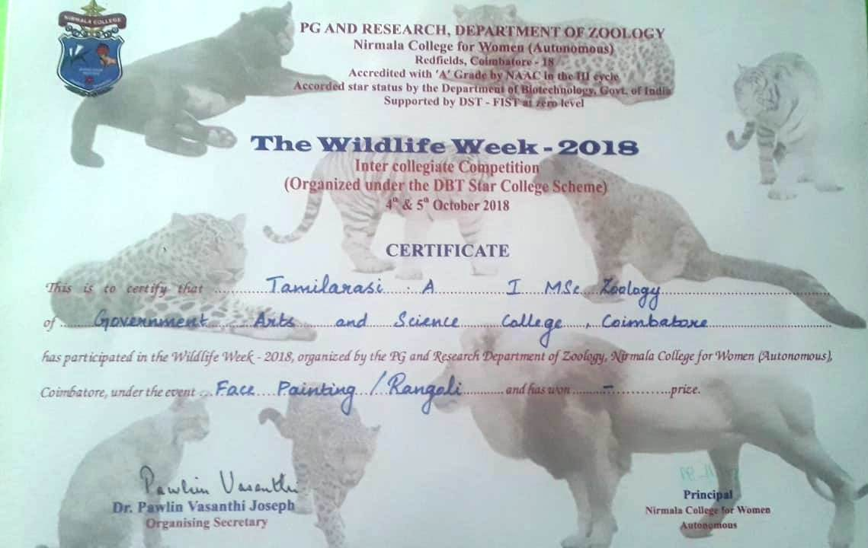
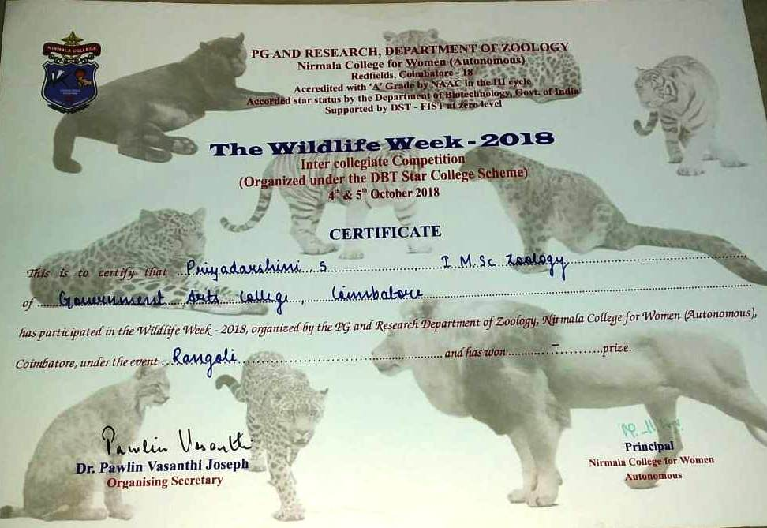
RANGOLI COMPETITION

Slide 6
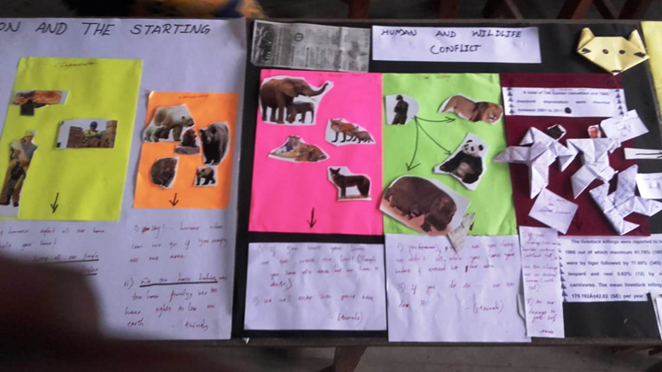
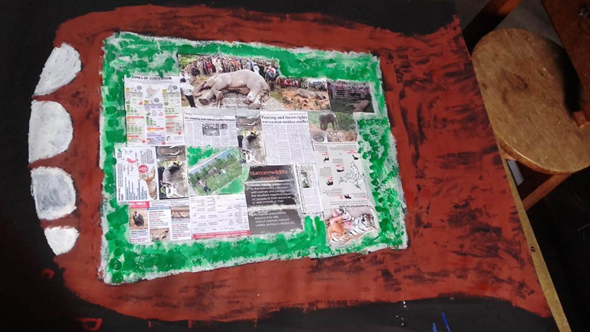
COLLAGE COMPETITION
OUR STUDENTS’ CREATIONS
FIRST PRIZE ENTRY
Mr. S M Premkumar
THIRD PRIZE ENTRY
Mr. V Bharathi

Slide 7
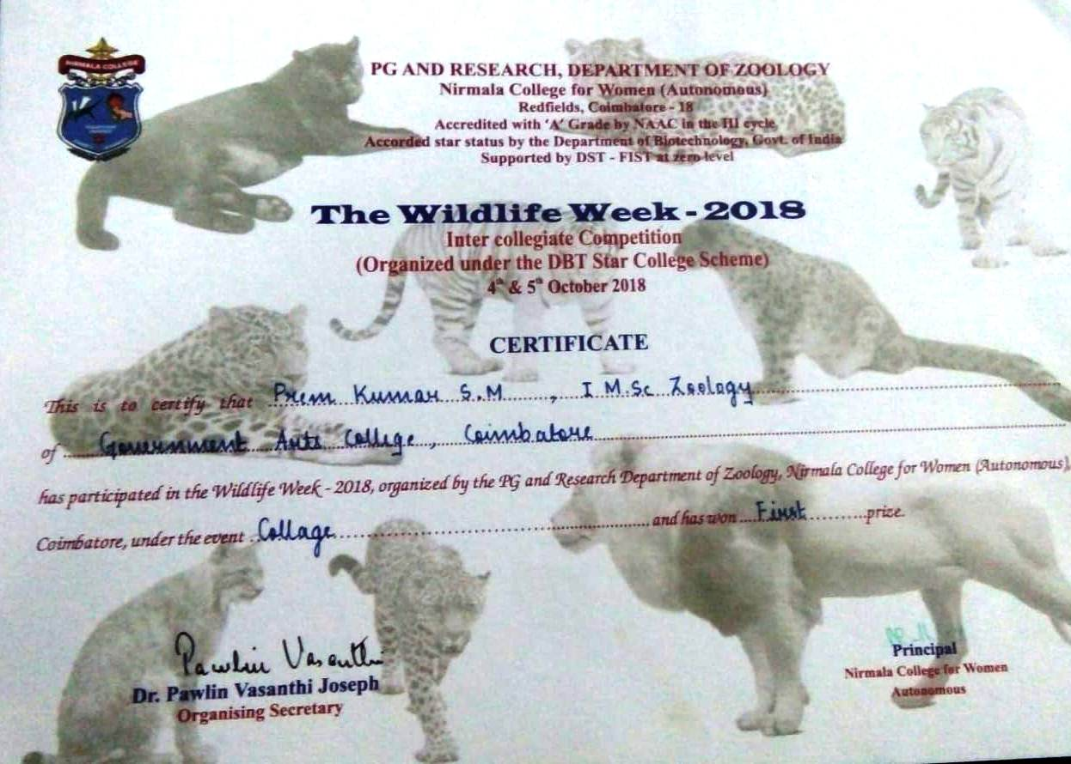
COLLAGE COMPETITION

Slide 8
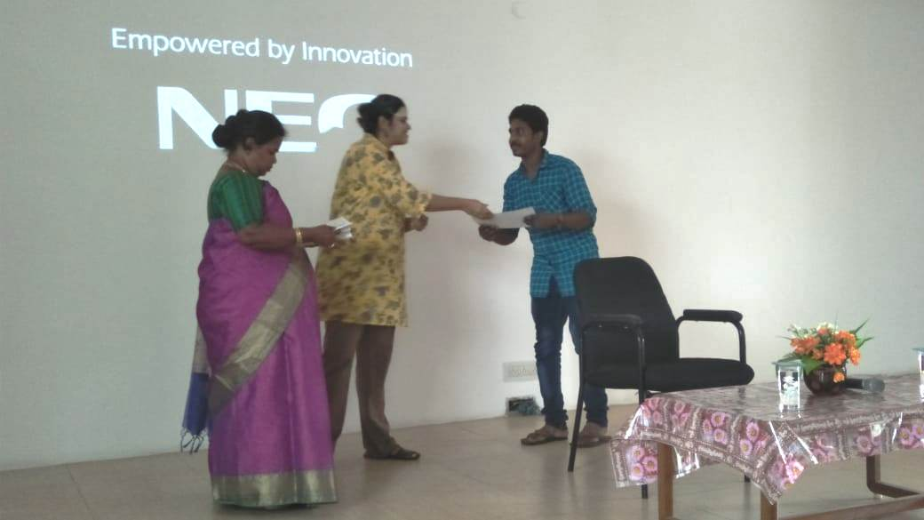
COLLAGE COMPETITION

Slide 9
FACE PAINTING COMPETITION

Slide 10
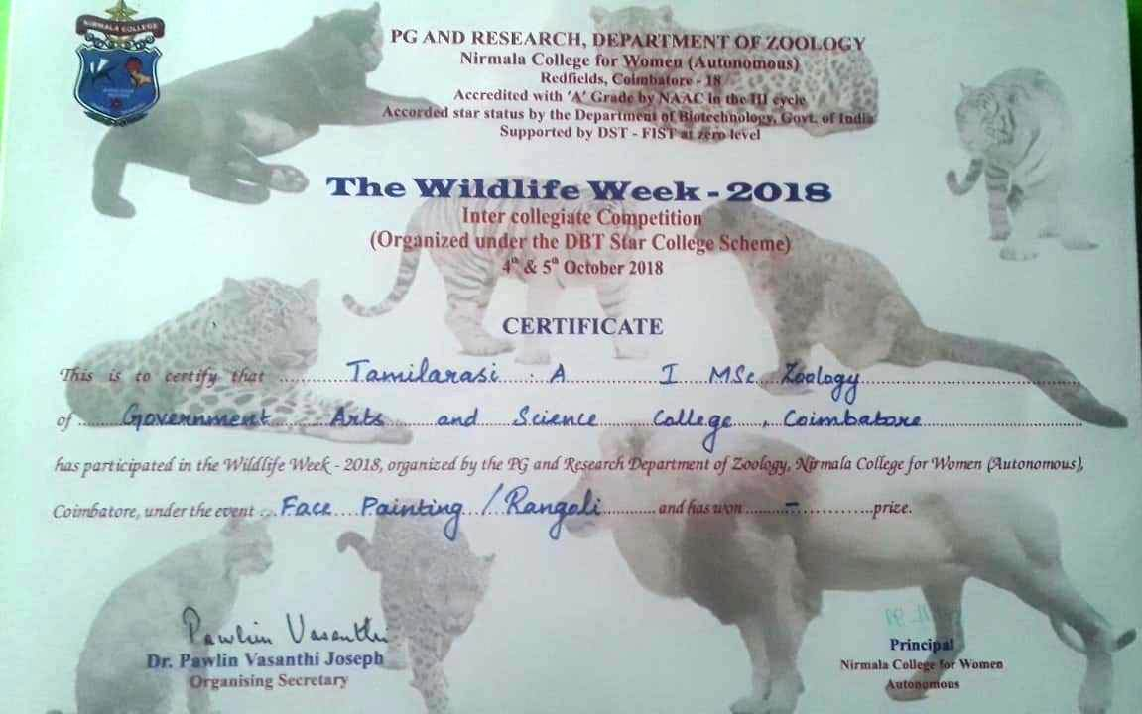
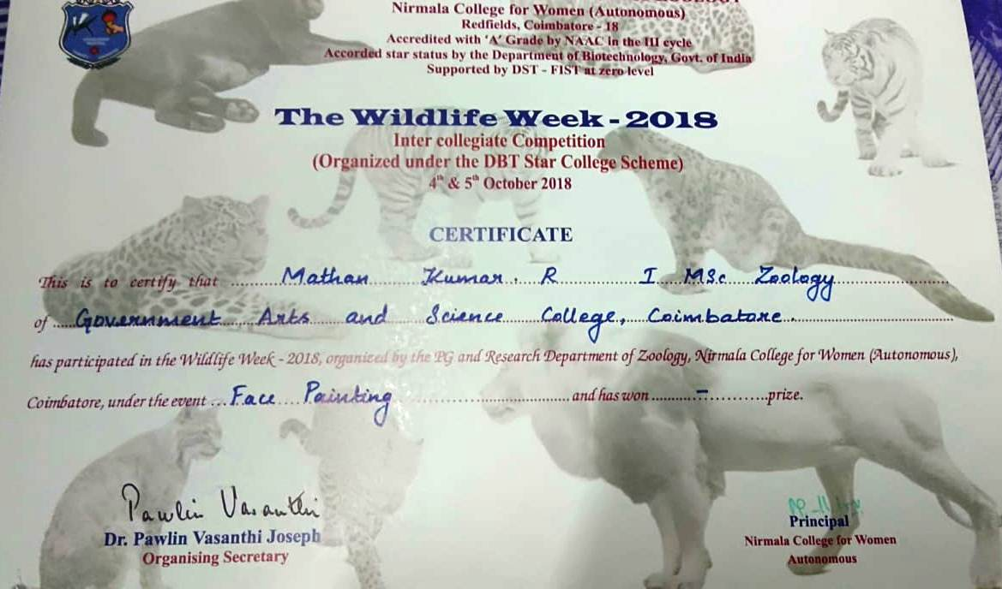
FACE PAINTING COMPETITION

Slide 11
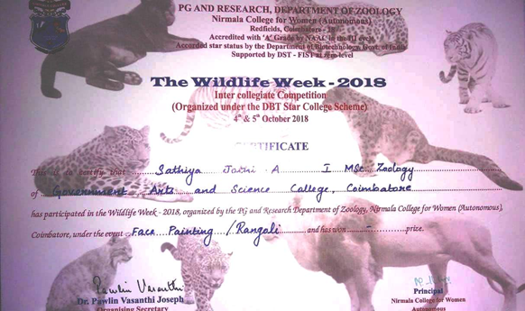
FACE PAINTING COMPETITION

Slide 12
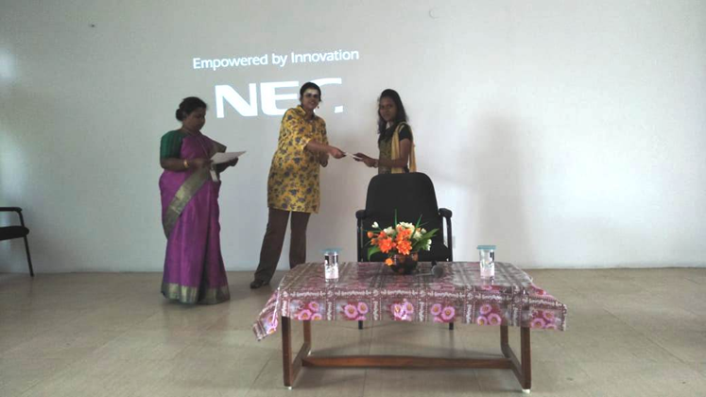
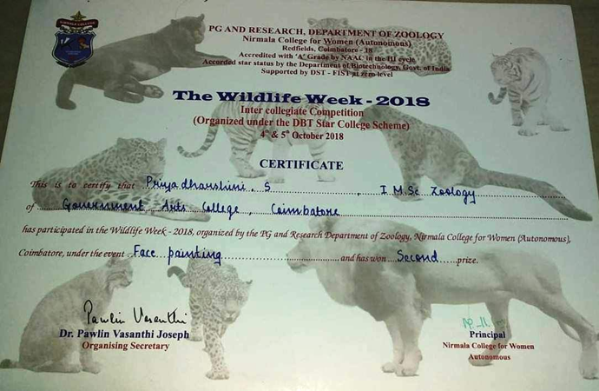
FACE PAINTING COMPETITION
Ms. S Priyadharshini
SECOND PRIZE

Slide 13
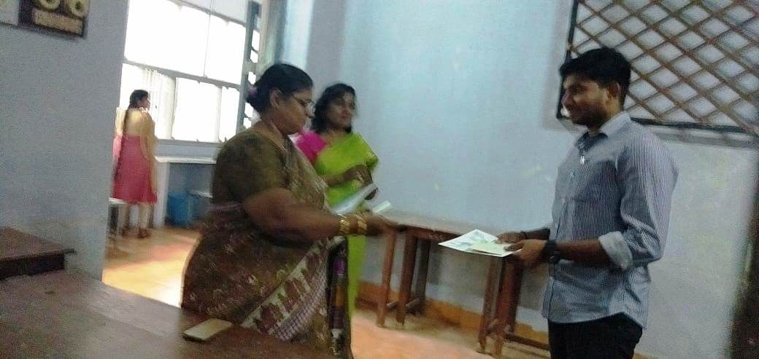
Felicitations to prize winners by the head of the department

Slide 14
accolades to the prize winners by the PRINCIPAL, GOVERNMENT ARTS COLLEGE, COIMBATORE

